Slide 1

Section 1.3 Floating Point Representation
Lecture 2
IEEE Floating Point Standards
Notes:
Section is shorter than most

Slide 2
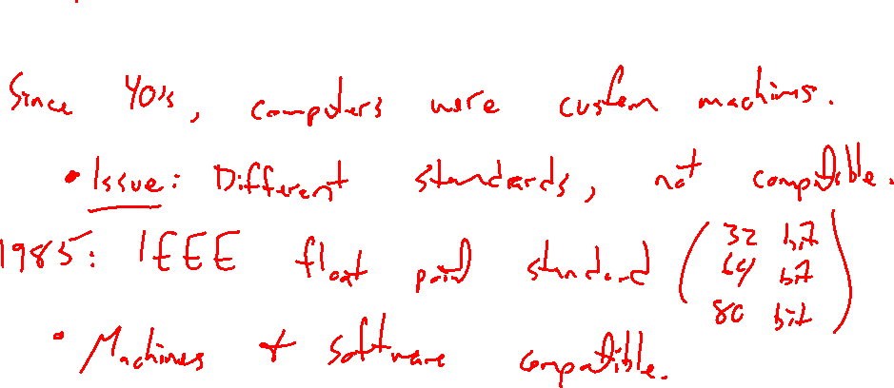
IEEE Standards: Why bother?
Notes:
Standard for computer storage of data
Make all machines / software compatible
First real industry standard

Slide 3
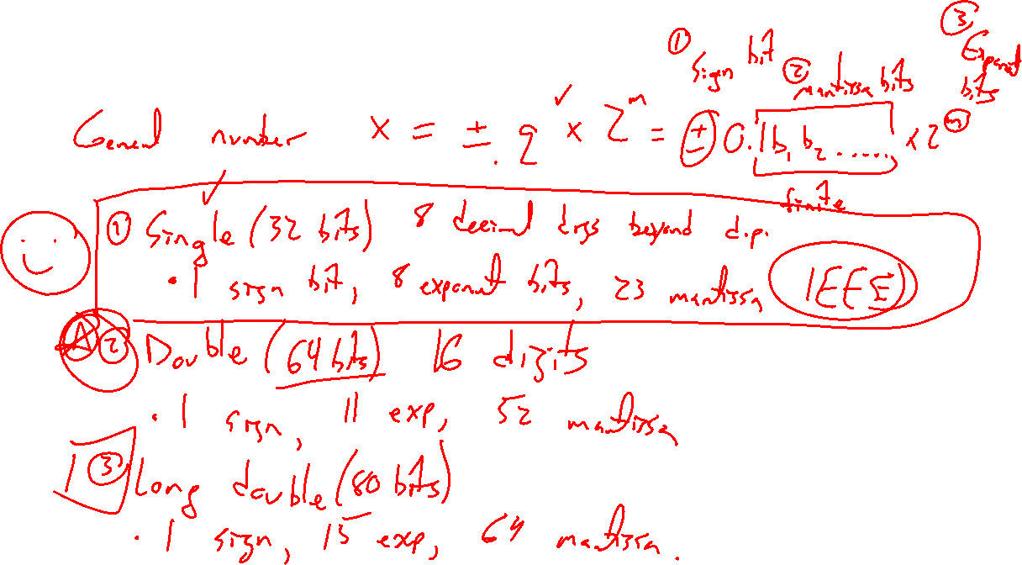
3 Standard Representations
Notes:
General number: x = +- q x 2^m = +- 0.1 b_1 b_2 …. x 2^m
Single: 32 bits, 1 sign, 8 exponent, 23 mantissa
Double: 64 bits, 1 sign, 11 exponent, 52 mantissa
Long double: 80 bits, 1 sign, 15 exponent, 64 mantissa

Slide 4

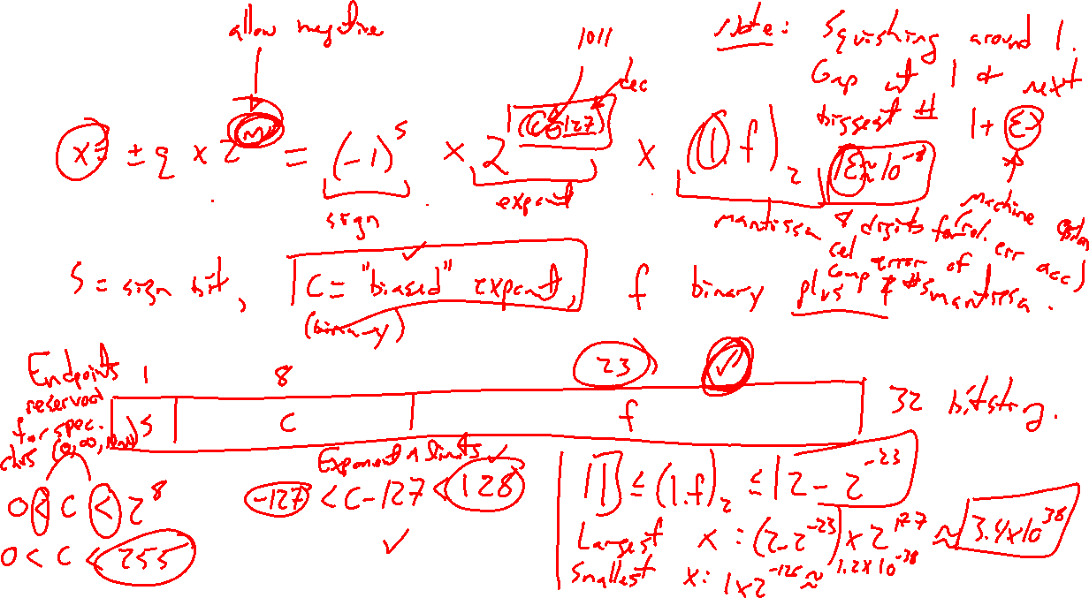
Single precision (32 bits)
Notes:
General form: (-1)^s x 2^{c-127} x (1.f)_2
S is sign bit, C is biased exponent, F binary 1 plus mantissa
Draw as 32 bit block, 0< c < 255 (endpoints reserved for sp chars inf, nan), then –126 <= c <= 127
Mantissa 1<= (1.f)_2 <= (2-2^{-23})
Largest number is then (2-2^{-23})x2^{127} \approx 3.4 x 10^38
Smallest number is then (2-2^{-23})x2^{-126} \approx 1.2 x 10^{-38}
Machine epsilon is then \eps = 2^{-24} \approx 5.96 x 10^{-8} (giving 8 digits of relative accuracy)

Slide 5
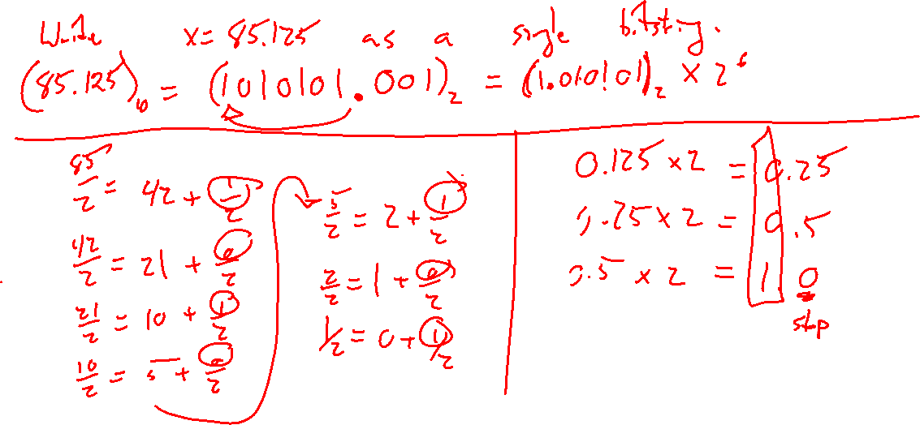
Example: Try on own
Notes:
Write 85.125 as single bitstring.

Slide 6
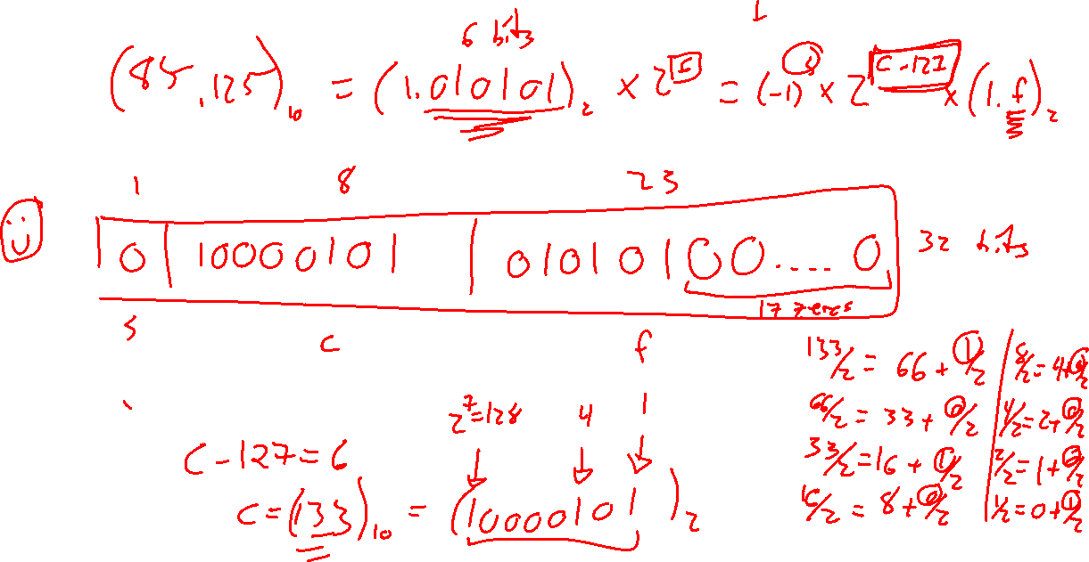

Slide 7
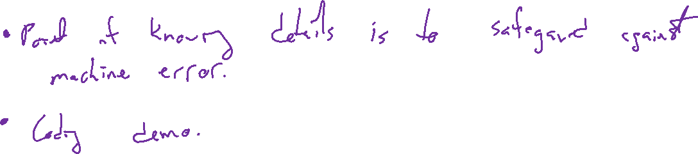
Summary
Notes:
Double (64 bit) discussion in text
Need be mindful of rounding issues related to precision, text handles more carefully
Coding demo

Slide 8
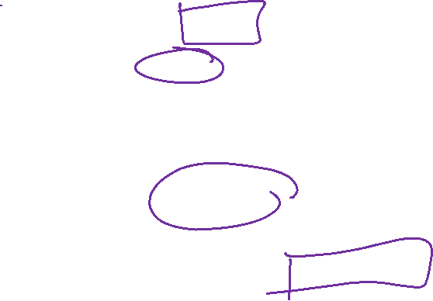
Section 1.3: Textbook Examples and Exercises
Theorem proofs: None
Text examples 1, 2.
Write down a problem. Close the book and attempt on own.
Check / correct your solution against the text solution.
If needed, rewrite the problem to be of the quality of the text solution.
Text exercises 1, 2, 5, 11.
Write solutions of the same quality as in lecture and text solutions.
Text computer exercises 1, 2, 4, 9.
Record screenshots of your script and corresponding outputs.
Notes:
Recommend 3blue1brown Taylor series video

Slide 9
Homework Submission to Canvas
Preview of section
Skim the section in text and write a short paragraph summary.
Give a bulleted list of all important definitions, theorems, and formulas without details.
Notes on video lectures
Take notes on everything written on slides including all details, worked examples, on-own activities, as well as your own thoughts and questions.
Try on-own activities first, then write down provided solution next to it for comparison.
Worked examples from the text
Write down the problem and attempt without looking at the solution.
Use the solution to write the best explanation you can.
Solutions to textbook exercises
Model approaches and explanations given in the video lectures and textbook examples.
Final reflection of section
List the key takeaways to remember as a bulleted list.

